Slide 1
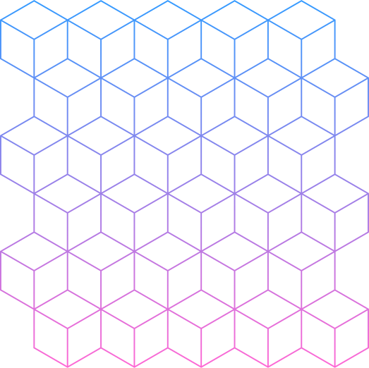

GROUP 02
Picture This:
Evaluating the Effectiveness of CNN + LSTM and ResNet + GRU

Slide 2
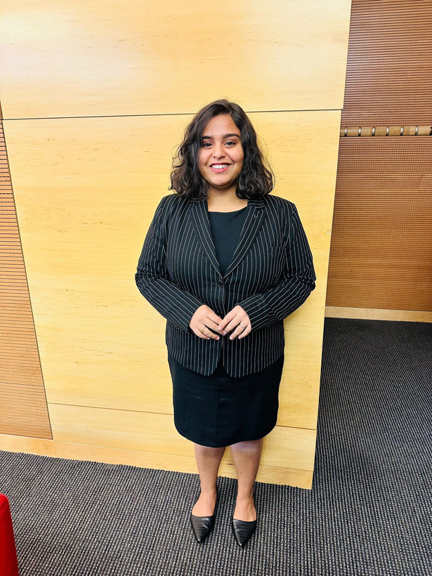
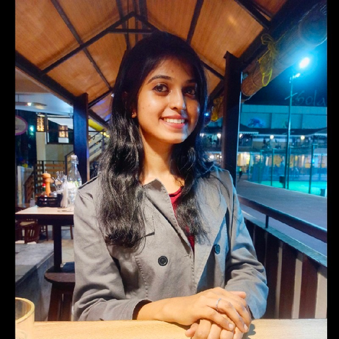
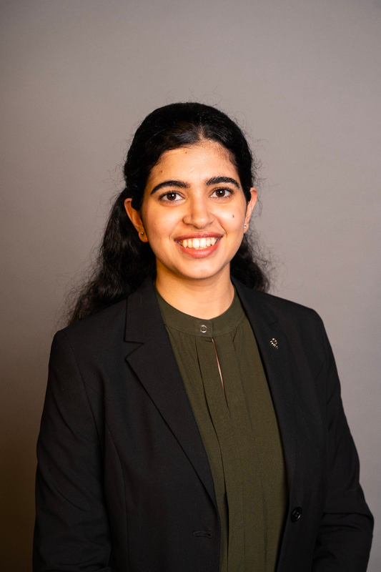
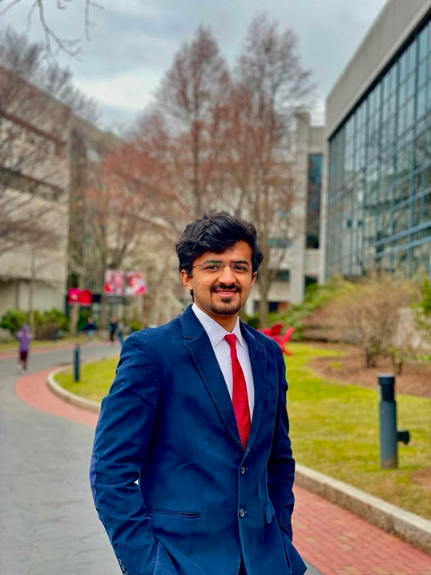
Group Members
RUCHI KAPADIWALA
002772936
APARNA
CHAVAN
002799851
ASHI
TYAGI
002706544
PARTH
KALANI
002766306
BACK TO AGENDA

Slide 3
Problem Statement
Technical Approach
Understanding the Dataset
Results
CNN Model
Comparision
LSTM Model
Conclusion
GRU Model
ResNet Model
Agenda

Slide 4
Problem Statement
GROUP 02
The comparison will be based on the BLEU scores, and the goal is to evaluate the effectiveness of these approaches in generating accurate and informative captions for images.
The problem we are tackling today is the task of automated image captioning using two different approaches, namely CNN + LSTM and ResNet + GRU.
The aim is to compare the performance of these methods on the Flickr 8k Dataset, using pretrained CNN/ResNet models to demonstrate the approaches.
BACK TO AGENDA

Slide 5
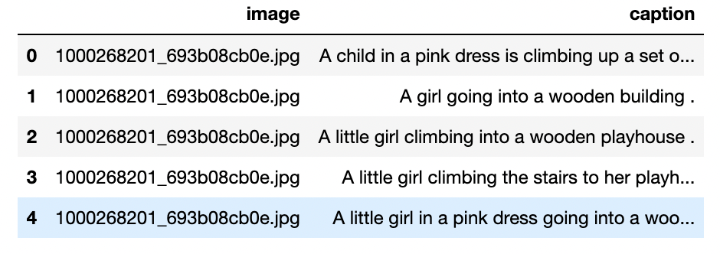
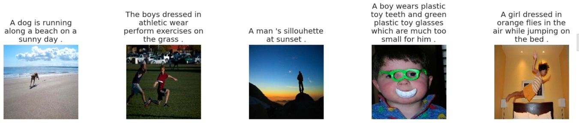
Understanding the Dataset

Slide 6

It contains a collection of 8,000 images, each with 5 different captions written by human annotators, resulting in a total of 40,000 captions.
GROUP 02
DATA DESCRIPTION
The dataset is split into three subsets: 6,000 images for training, 1,000 images for validation, and 1,000 images for testing.
Flickr8 Dataset
Flickr8k dataset is a popular benchmark dataset for the task of automated image captioning.
BACK TO AGENDA

Slide 7
The images in the dataset cover a wide range of categories, including people, animals, landscapes, and objects.
GROUP 02
DATA DESCRIPTION
Flickr8 Dataset
The dataset is useful for evaluating the performance of image captioning models, as it provides a standardized benchmark for comparison.
BACK TO AGENDA

Slide 8
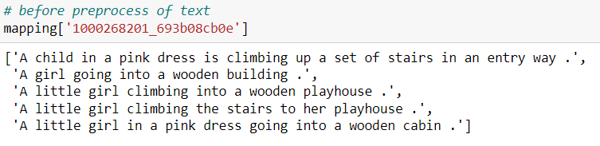
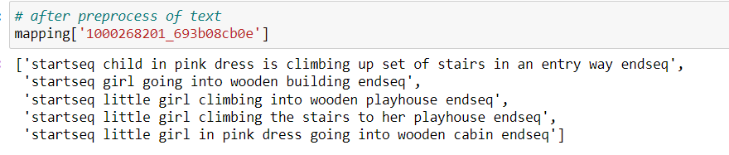
Data Preprocessing​
Preprocessing the captions by converting them to lowercase, removing special characters and whitespace, joining the words with spaces, and adding startseq and endseq tokens to indicate the beginning and the ending of a sentence
BACK TO AGENDA

Slide 9

What is CNN Model?​
01
CNN stands for Convolutional Neural Network, which is a type of deep learning model that is commonly used for image and video processing tasks.
02
CNN models are composed of multiple layers, including convolutional layers, pooling layers, and fully connected layers.
03
Convolutional layers perform a set of convolutions with a set of learnable filters, which helps to detect features such as edges, corners, and shapes in the image.
04
Some popular CNN models include AlexNet, VGGNet, GoogLeNet, ResNet, and InceptionNet.
BACK TO AGENDA

Slide 10
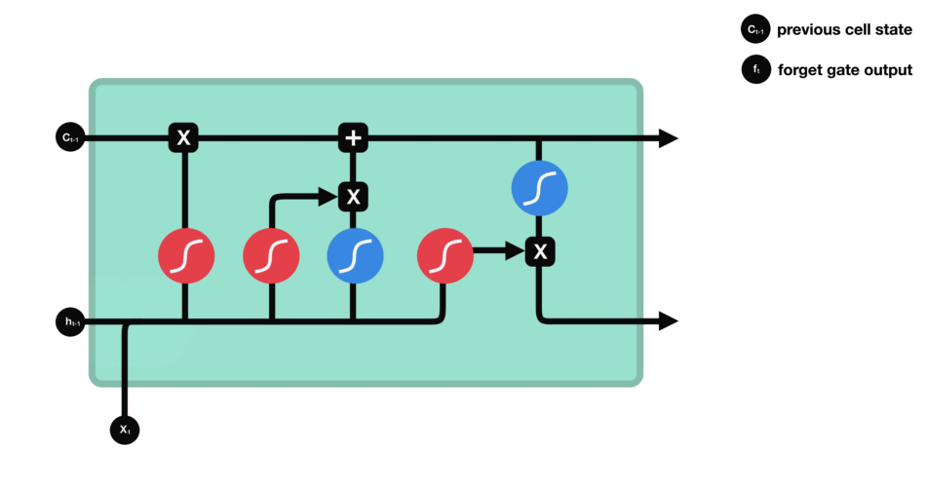
What is LSTM Model?​
01
LSTM (Long Short-Term Memory) is a type of recurrent neural network (RNN) that is commonly used for processing sequential data.
02
LSTM models are controlled by three gates - the input gate, the forget gate, and the output gate - that regulate the flow of information in and out of the cells.
The input gate determines which information to let in, the forget gate determines which information to forget, and the output gate determines which information to output.
03
04
This architecture allows the LSTM model to selectively remember or forget information over time, making it well-suited for processing sequential data.
BACK TO AGENDA

Slide 11
CNN +LSTM
01
To perform Image Captioning we will require two deep learning models combined into one for the training purpose
CNNs extract the features from the image of some vector size aka the vector embeddings. The size of these embeddings depend on the type of pretrained network being used for the feature extraction
02
LSTMs are used for the text generation process. The image embeddings are concatenated with the word embeddings and passed to the LSTM to generate the next word
03
04
For a more illustrative explanation of this architecture check the Modelling section for a picture representation
BACK TO AGENDA

Slide 12
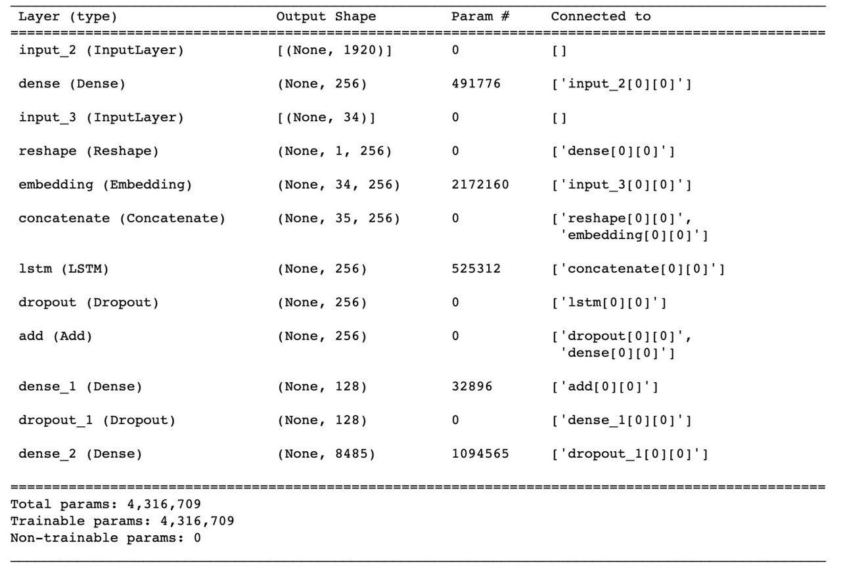
High Level View of the Model
BACK TO AGENDA

Slide 13
High Level View of the Model
BACK TO AGENDA

Slide 14
What is ResNet?​
ResNet is a type of deep neural network architecture designed to address the problem of vanishing gradients that can occur when training very deep neural networks.
01
The key innovation of the ResNet architecture is the use of skip connections (also called residual connections) between layers of the network.
02
03
Residual connections allow gradients to flow more easily through the network, which makes it easier to train very deep networks.
There are several variants of the ResNet architecture, including ResNet-50, ResNet-101, and ResNet-152, which differ in the number of layers and other architectural details.
04
BACK TO AGENDA

Slide 15
What is GRU?​
GRU (Gated Recurrent Unit) is a type of recurrent neural network (RNN) architecture that was introduced in 2014 as a simpler alternative to the more complex LSTM (Long Short-Term Memory) architecture.
01
GRUs are designed to address the problem of vanishing gradients that can occur in standard RNNs when they are trained on long sequences of data.
02
GRUs use gating mechanisms to control the flow of information through the network, with a reset gate and an update gate determining how much of the previous state to forget and how much of the new state to retain.
03
04
GRUs have been found to be faster to train and require fewer parameters than LSTMs, while achieving similar performance on many tasks.
BACK TO AGENDA

Slide 16
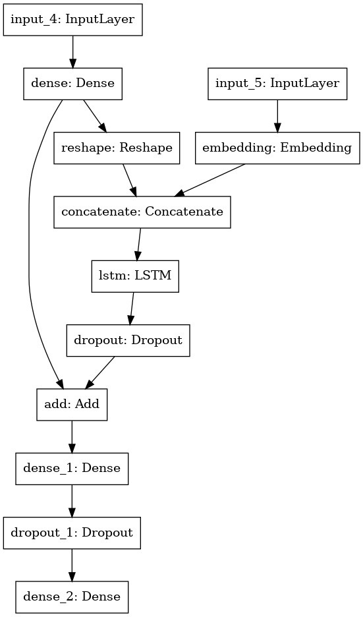
Architecture
BACK TO AGENDA

Slide 17
Technical Approach​
Data Preprocessing:​
a. Extract features from the images in the directory using the VGG16 model and preprocess the image for the VGG model.​
b. Store the extracted features in a dictionary and save the dictionary as a pickle file.​
c. Load the features from the pickle file and the captions from the captions.txt file.​
01
Split into training and testing:​
1. Split the image IDs into train and test sets.​
2. Create a data generator to get data in batches and encode the sequences.
02
BACK TO AGENDA

Slide 18
Technical Approach​
03
The first part of the model is a CNN that extracts features from the input images. The CNN architecture used in this code consists of three convolutional layers with 32, 64, and 128 filters respectively, each followed by a MaxPooling2D layer to downsample the output. ​
04
ResNet152v2 is a convolutional neural network architecture used for image recognition tasks. It has 152 layers and is an improvement over the original ResNet152 model, using additional techniques such as batch normalization and improved residual connections. ResNet152v2 has achieved state-of-the-art performance on various image recognition benchmarks.​
BACK TO AGENDA

Slide 19
Technical Approach​
05
The second part of the model is an LSTM network that takes the 1D feature vector from the CNN as input and processes it to predict the classification of the image.
06
GRU (Gated Recurrent Unit) is a type of recurrent neural network (RNN) architecture that uses gating mechanisms to improve long-term dependencies learning and prevent vanishing gradient problem. It is similar to LSTM (Long Short-Term Memory) but has fewer parameters and can be faster to train.
07
Model Testing:​
a. Load the saved model weights.​
b. Use the model to generate captions for new images.​
c. Evaluate the generated captions using metrics such as BLEU​
BACK TO AGENDA

Slide 20
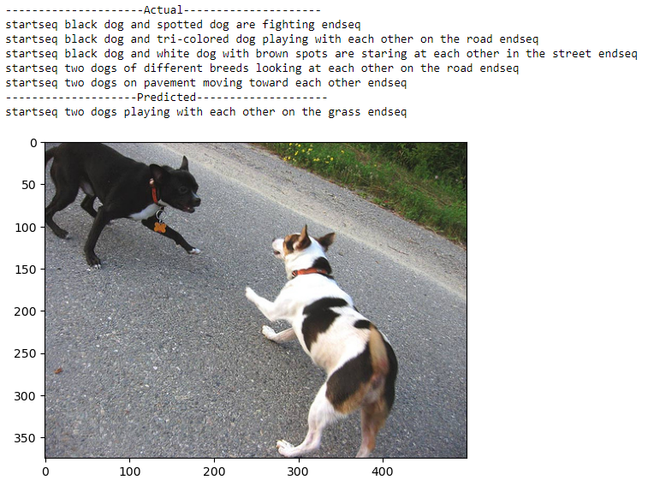
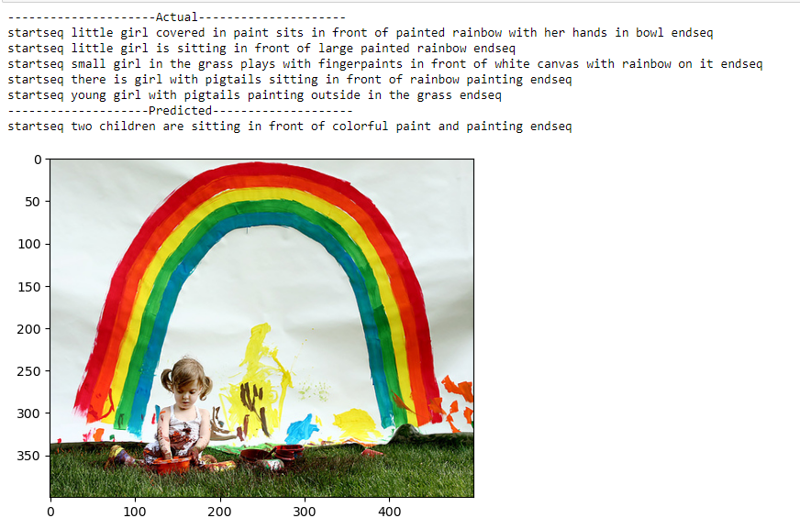
Results - CNN + LSTM
BACK TO AGENDA

Slide 21
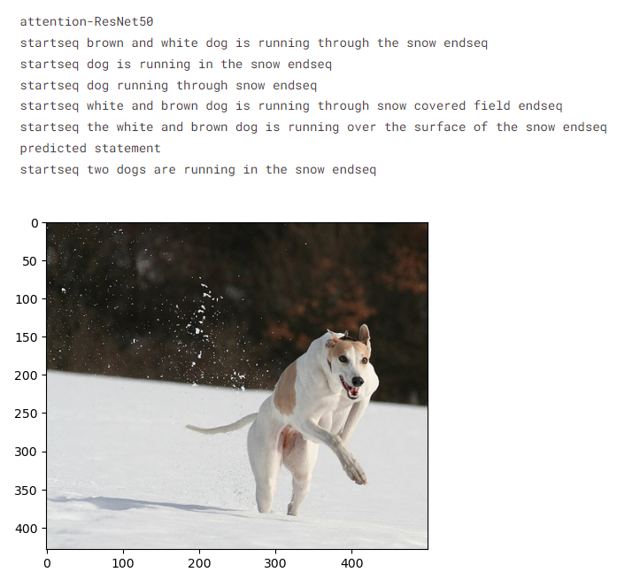
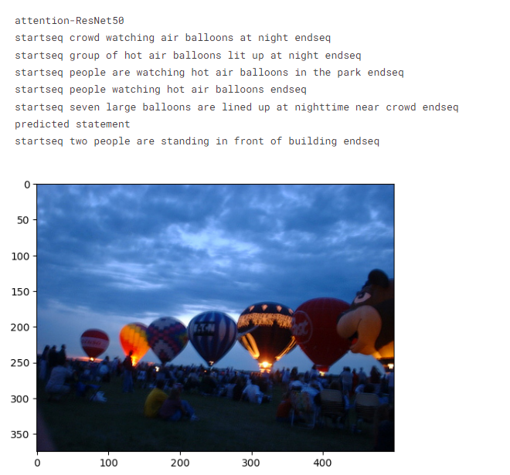
Results - ResNet + GRU
BACK TO AGENDA

Slide 22
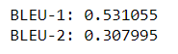
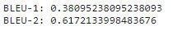
BLEU Score
The BLEU (Bilingual Evaluation Understudy) score is a metric used to evaluate the quality of machine translation outputs by comparing them with one or more reference translations. ​
The score ranges from 0 to 1, with 1 being a perfect match with the reference translations
CNN + LSTM
ResNet + GRU
BACK TO AGENDA

Slide 23
Conclusion
Based on the given results, it can be concluded that the CNN + LSTM model performs better than the ResNet + GRU model for image caption prediction using the flickr8 dataset. The CNN + LSTM model achieved a higher BLEU-1 score (0.53) compared to the ResNet + GRU model (0.38), indicating that the CNN + LSTM model generated more accurate and relevant captions for the images.​
However, the ResNet + GRU model achieved a higher BLEU-2 score (0.61) than the CNN + LSTM model (0.30), which suggests that the ResNet + GRU model performed better in generating captions with better syntactic structure and n-gram overlap.​
BACK TO AGENDA

Slide 24

THANK YOU!
CAPTION: POTTED PLANT ON CHAIR ON BOOKS

